Slide 1
CYBER SECURITY UPSKILLING PROGRAM قدم خلال مبادرة زنك/2 في جامعة البلقاء التطبيقية بالتعاون مع أكاديمية سايبر شيلد OCT 2024 Digital Forensics Part Version 1
INST.:ENG.ALI BANI BAKAR-0778642376(CYBER SHIELD ACADEMY)
DONE BY: ENG. Dana Al-Mahrouk-0798697842-BAU.UNIV.

Slide 2
Outline
Networks
Linux Essentials
Cybersecurity Foundation
Ethical Hacking
Digital Forensic Investigation

Slide 3
Day 18
Outline
Digital Forensics
Knowledge of Digital Forensics
Steps of Digital Forensics
Scenario
Best Practices
Memory
Virtual Memory
Custom Content Image
Forensic Image
AccessData FTK Imager
RAM Image

Slide 4
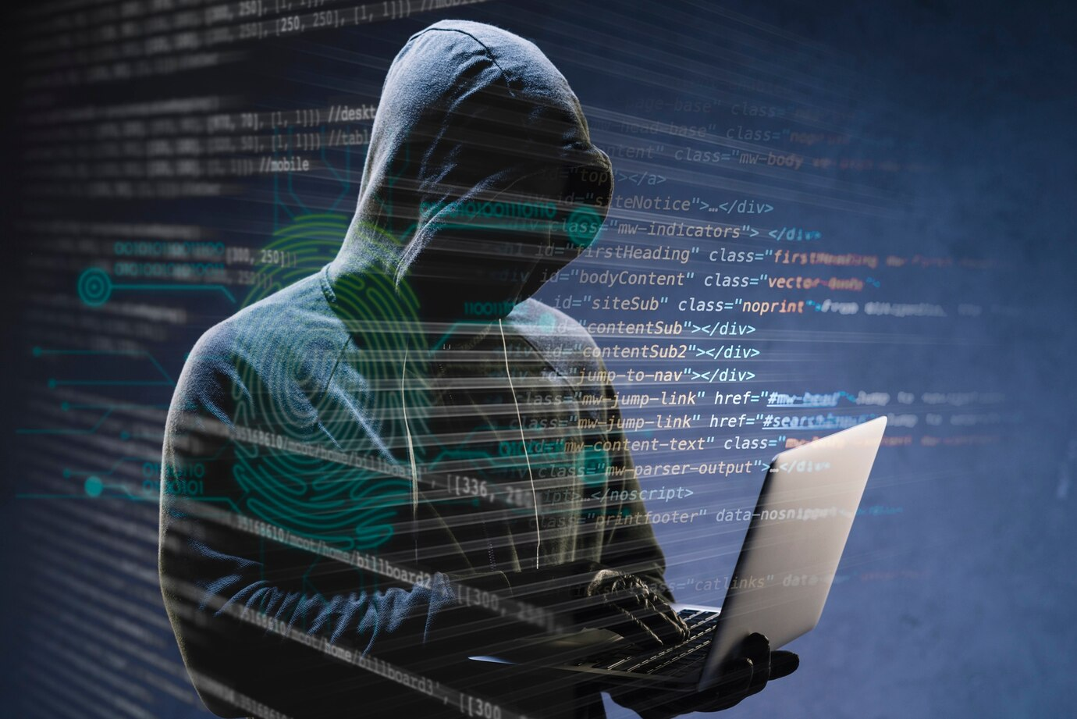
Digital Forensics
Digital forensics is the process of collecting, preserving, analyzing, and presenting digital evidence from digital devices in a way that is legally acceptable.
To uncover information that can be crucial in investigations related to cybercrimes.

Slide 5





Digital Forensics
Complete Evidence:
gathering all possible data that could be relevant to the investigation.
Evidence:
any digital information that can be used to support or refute claims made during an investigation.
Primary Forensic Evidence:
original digital data that is directly collected from devices involved in the investigation.
Digital Crime:
any illegal activity that involves computers, networks, or digital devices.

Slide 6







Knowledge of Digital Forensics
7
Operating Systems
Networking and Network Security
Malware Analysis
Data Recovery Techniques
Programming and Scripting Skills
Incident Response and Investigation
Digital Evidence and Forensic Tools

Slide 7
Steps followed in the digital forensics process
1
Identification: Identify the devices and data sources involved, Understand the type of digital crime or incident that has occurred.
2
Preservation: Create a forensic image (exact copy) of the data using specialized tools to avoid altering the original evidence.
3
Examination: Analyze the collected data to extract meaningful information and uncover evidence that may be useful in understanding the incident. (Recover deleted, hidden, or encrypted files)
4
Analysis: Interpret the data to identify patterns, relationships, or connections that can help explain the incident.(Determine the root cause of the incident, the attacker's methods, and the impact on the system)
5
Documentation: Record all the findings, methods, tools, and processes used during the investigation to create a comprehensive report.
6
Presentation: Present the results of the analysis in a clear and understandable manner, suitable for legal proceedings or organizational decision-making.

Slide 8



Cyber ​​crime scenario in the bank
Please help me, the bank is being hacked now.
How damaging is this attack?
Please stay calm and focused now, do not allow employees to touch the attacked device until I arrive.
The damage is very bad, we can't afford any more losses.
Well, the attack is very simple and we can work with this attack and bear the loss for a long time.
Ok, keep working and do not allow the internet to be disconnected or to touch the victim device until I can catch the hacker red-handed.
Ok, disconnect the internet.

Slide 9





Cont…
Reached.
Go directly to the infected device and take a image/snapshot of the RAM.
Use: FTK-Lite inside USB
- Capture volatile data (RAM, active network connections, running processes)
Installing a heavy program to take a picture of the RAM in the device causes problems (the RAM will be overwritten)
FTK Imager Lite:
used for its speed, portability, and effectiveness in creating forensic images while maintaining data integrity.

Slide 10
Best Practices
1
Disconnect the compromised systems from the network to stop the attacker's access without shutting them down completely (to avoid losing volatile data).
2
Ensure that all evidence is preserved in its original state. Use forensic tools to create bit-by-bit copies of data before performing any analysis.
3
Maintain a detailed record of every action taken during the investigation, including the collection, handling, and transfer of evidence and Document the timeline of events. This ensures that the evidence is admissible in court.
4
Analyze system logs, network traffic, file timestamps, and other relevant data to identify how the attack occurred, what systems were affected

Slide 11
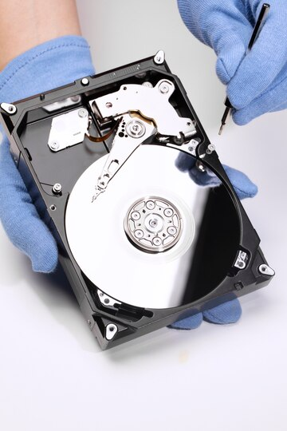





Get complete evidence from hard disk
Obtaining complete evidence from the hard disk…
You must ensure that the flash drive has sufficient space to obtain an image of the entire hard disk (bit by bit), in order to ensure that you obtain the deleted data.
0.5 TB Data Used
4 TB Total
1 TB Flash
4 TB Flash

Slide 12
Digital Forensics Phases
1
2
3
RAM image
Check HD Encryption
Triage image
4
5
Analyze RAM & Triage
Image
Hard disk Image

Slide 13
Memory
CPU
Cache Memory
Small + Fast
Main Memory (RAM)
OS data, running Apps
Big + Slow
Hard Disk Memory
OS + All Programs & Data
Magnetic Tape

Slide 14
Virtual Memory → Key Files in Hard disk
Paging File (pagefile.sys)
Paging File:
When the RAM is full, paging file to store parts of memory that aren't actively used. This process is called "paging”
Hibernation File (hiberfil.sys)
Hibernation File:
During hibernation mode, the RAM are saved to this file on the so that the system can completely power down.
Windows Swap File (swapfile.sys)
Windows Swap File:
works alongside pagefile.sys to handle memory paging and reduce memory usage by temporarily storing data.
MBR
(FAT) / (NTFS)
Metadata Files
Log Files
Recovery and System Reserved Partitions

Slide 15
Custom Content
1) SAM (Security Account Manager): Stores hashed passwords for user accounts on the local machine.
2) Security: Contains security settings and policies applied to the system.
4) System: Contains settings related to the hardware and system configuration, including services and drivers.
3) Software: Holds information about installed software and configuration settings.

Slide 16

Forensic Image
NTUSER.DAT: the user's registry hive (user-specific settings, recent activity, executed programs, recently accessed files, and more).
Event Logs (*.evtx): These logs record all the events happening on the system, such as logins, file access, errors, and software installation. → timeline of activities.
Windows Registry (SAM, Security, Software, and System hives) data about system's configuration, installed software, security settings, and user accounts.
pagefile.sys, hiberfile.sys, and swapfile.sys contain fragments of memory (RAM) that have been temporarily stored on the hard disk. This data often includes passwords, encryption keys, URLs, running processes, and other sensitive information that would otherwise be lost when the system is powered down.

Slide 17

AccessData FTK Imager
AccessData FTK Imager: is a forensic imaging tool used to create exact copies of data from hard drives, removable media, and other storage devices.
E01 (EnCase image file)
DD (raw image)
AD1 (AccessData custom image file)
It ensures the integrity of the data by generating hash values (MD5, SHA-1)
preview the contents of files and folders on a drive before imaging.
display detailed information about the file system, including deleted files, hidden files, and system files.
supports multiple file systems, including `FAT, NTFS, exFAT, HFS+, EXT2/3/4`.

Slide 18
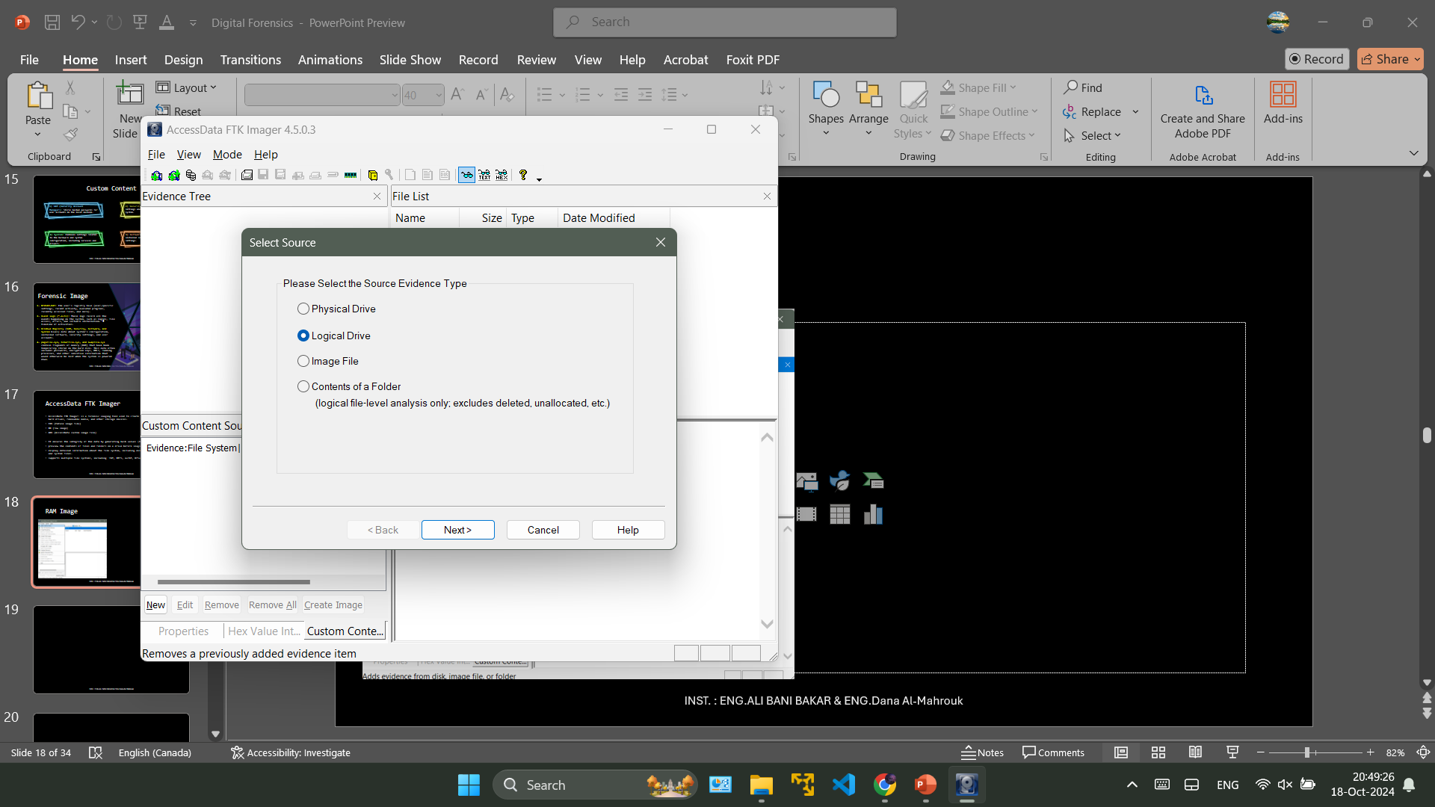
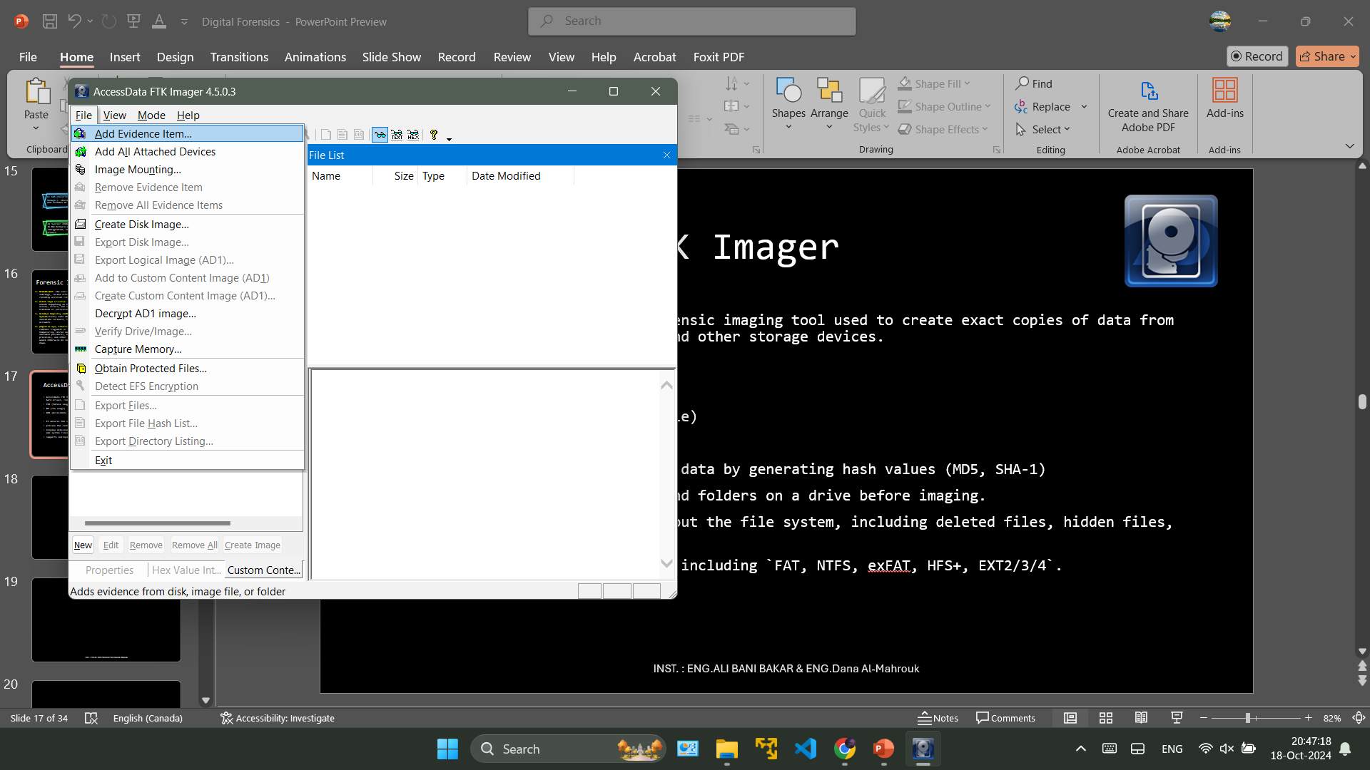

RAM Image

Slide 19
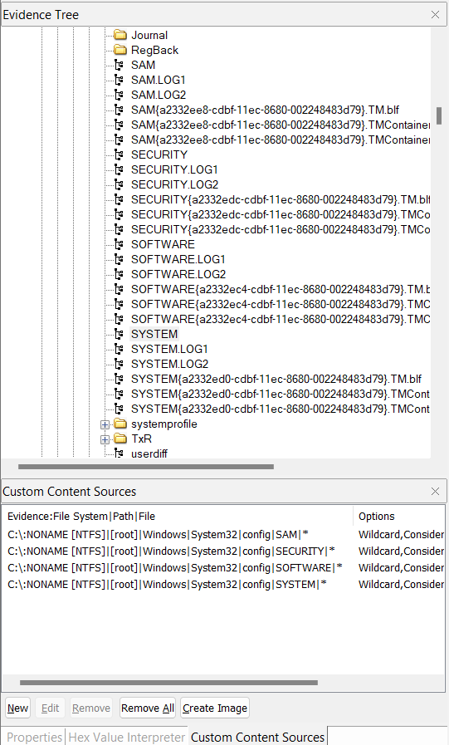
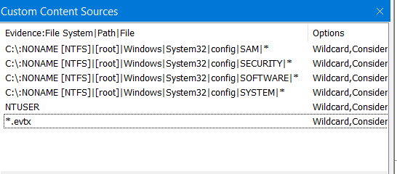
RAM Image
File → Add Evidence Item → Logical Drive → C:\-[NIFS] → Finish
Custom Content Source:
Evidence Tree:
C:\ → NONAME[NIST] → [root] → Windows → System32 → config → SAM + SECURITY + SOFTWARE + SYSTEM
Right click → Add to Custom Content Image (AD1)
New → Edit → NTUSER + *.evtx
File → Export Logic Image (AD1) → Add …

Slide 20
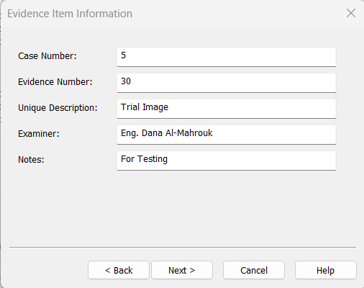
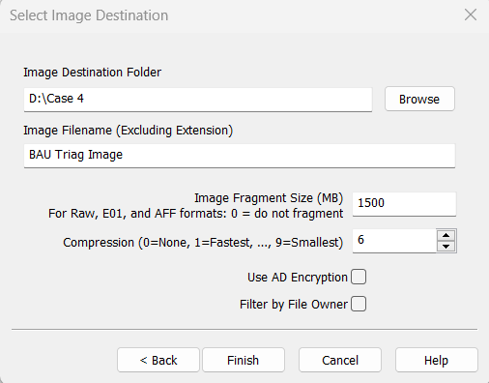
Export Logic Image (AD1)

Slide 21
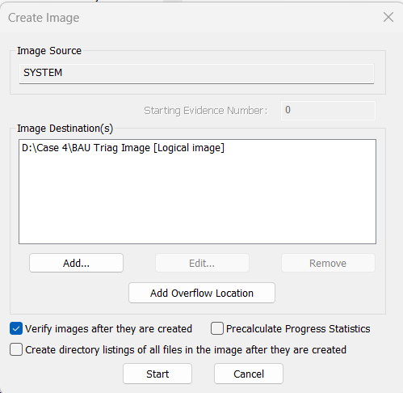
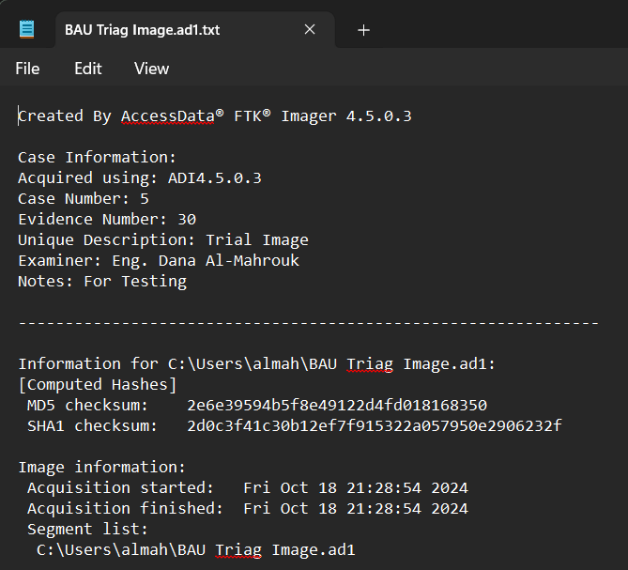
Export Logic Image (AD1)

Slide 22
Day 19
Outline
Hard disk (Trunk, Sector, Cluster)
Cluster Size
booting a Windows OS
File Wiping (Data Erasure)
File Recovery
Formatting
File Wiping issues
C Language for OS
Create Disk Image
Disk Mounting

Slide 23
Hard disk
Trunk
Trunk:
Sector: 512 byte
the smallest unit of data storage on a hard disk, physical units that the disk hardware reads and writes.
Cluster: (allocation unit)
A group of sectors that the file system uses to manage data on the disk.
The cluster size depends on the file system and partition size.
[optional → 2 sector]
1024 byte → 1 KB
Sector
Cluster

Slide 24
Q: sector=512-byte File size = 5.5KB
Device 1:
Cluster = 2 sector → 1024 bytes
Use 5 clusters ➔ 5125 bytes
Use 6 clusters ➔ 6144 bytes
Losses:
5 clusters Full + cluster (512 bytes)
Final File Size → 6144
Device 2:
Cluster = 4 sector → 2048 bytes
Use 2 clusters ➔ 4096 bytes
Use 3 clusters ➔ 6144 bytes
Losses:
2 clusters Full + cluster (512 bytes)
Final File Size → 6144

Slide 25
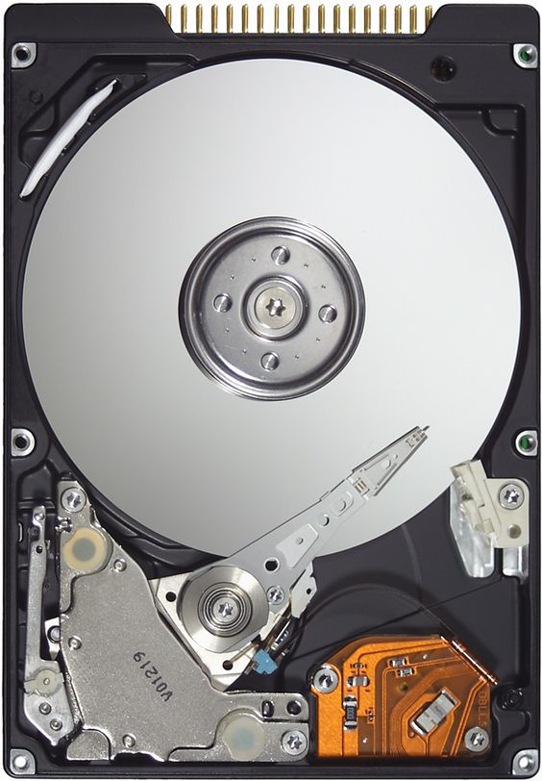
Cluster Size
Small Cluster:
loss spaces decrease (no empty spaces)
Long time to search / find data → read write
Big Cluster:
Loss spaces increase (a lot of empty spaces)
Fast in read / write

Slide 26
booting a Windows OS
File System: [NTFS], [FAT32], [FAT16].
OS → RAM [32-Bit] [64-Bit]
CPU → [32-Bit] [64-Bit]
File → start address, size

Slide 27
Ex:
Init Tag is 0
Linux:
touch note.txt
rm note.txt
touch note2.txt
touch flower.jpg
touch zinc.png
rm flower.jpg
rm zinc.png
touch w.doc
touch Book.txt
rm w.doc
touch BAU.exe
touch cat.jpg
Tag | Address | Data
0 → 1 → 0 → 1 | 00000000 | Note.txt → note2.txt
0 → 1 → 0 → 1 → 0 → 1 | 00000010 | Folwer.jpg → w.doc → cat.jpg
0 → 1 → 0 → 1 | 00000020 | Zinc.png → BAU.exe
0 → 1 | 00000030 | Book.txt
Test your knowledge
Q: A customer wants you to recover some deleted data from his device, what advice would you give him until he reaches you? → (Don’t Overwrite → File Recovery)
Q: How can we delete data while ensuring that no one can recover it? → (Overwrite Full Hard disk → File Wiping)

Slide 28

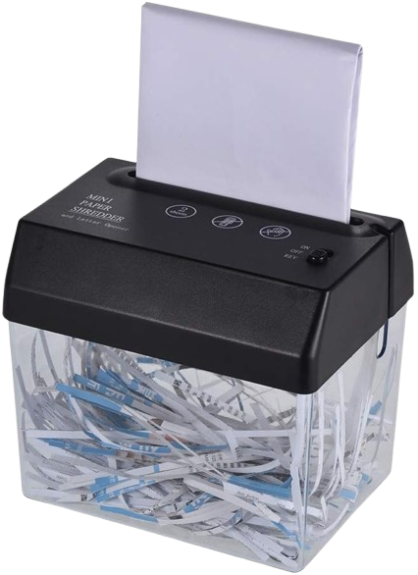
File Wiping (Data Erasure)
It involves overwriting the existing data with random patterns of ones and zeros multiple times to ensure the data is completely unrecoverable.
Single-Pass Overwrite: Writes over the data once. This is often enough for most users, but not the most secure option.
Multiple-Pass Overwrite: More secure methods like the DoD 5220.22-M standard perform three or more passes to overwrite the data, making recovery even harder.

Slide 29

File Recovery
File recovery is the process of restoring lost, deleted, or corrupted data from a storage device.
When a file is deleted, the os marks the space occupied by that file as available but does not erase the data itself. File recovery software can locate these "deleted" files and restore them if they have not yet been overwritten.
Overwriting: If new data has been written to the drive, it can overwrite the deleted files, making them impossible to recover.

Slide 30
Formatting
Formatting a drive prepares it for use by creating a file system on it (like NTFS, FAT32, or exFAT).
Quick Format:
Only deletes the file system's index (the table that tracks where files are stored) and sets up a new, empty file system.
It does not erase the data itself, the files can still be recovered using file recovery software until they are overwritten.
Full Format:
scans the drive for bad sectors and overwrites all the data with zeros, which significantly reduces the chances of data recovery.
more thorough and secure than a quick format because it not only removes the file system's index but also writes over the data.

Slide 31
HW
Q: The difference between making an image of the entire hard disk and making images of individual partitions or drives (like C:\, D:\, E:\, F:\)?

Slide 32
File Wiping issues
achieving 100% data deletion can be tricky due to a few technical reasons:
File System Complexity: Many modern file systems (like NTFS or ext4) keep metadata. Even after overwriting file contents, fragments of this metadata may still exist elsewhere on the disk.
Data Caching: OS and hard drives often cache data for quick access. Some of this cached data can persist even after deletion and might not be wiped in a standard deletion process.
Over-Provisioning on SSDs: SSDs use hidden areas for efficient write operations, which aren't accessible to standard wiping tools, leaving residual data.
Shadow Copies and Backups: Systems like Windows retain older file versions in backups, allowing deleted data to persist in snapshots.
Logical vs. Physical Deletion: Standard deletion removes only file pointers, not the data itself, which can still be recovered until overwritten securely.
To truly wipe data, specialized tools and techniques (like `secure erase` for SSDs, or `physical destruction` of storage media) are often needed.

Slide 33
C Language for OS
When installing a new OS or formatting a drive, leftover data from the previous system may remain because formatting usually only clears file pointers, not the actual data.
This residual data, including sensitive information, can be recovered by someone with access to the disk. To fully erase old data and prevent exposure, a secure wipe should be done before installing the OS.
int mem[100];
Old OS Space
New OS Space
int mem[200];
Here the operating system reserves more space on the hard disk, as the data is in the operating system space now, if the operating system does not use this space and if this data is sensitive then it can be read by anyone who checks the hard disk.
Data
Data
File Wiping

Slide 34
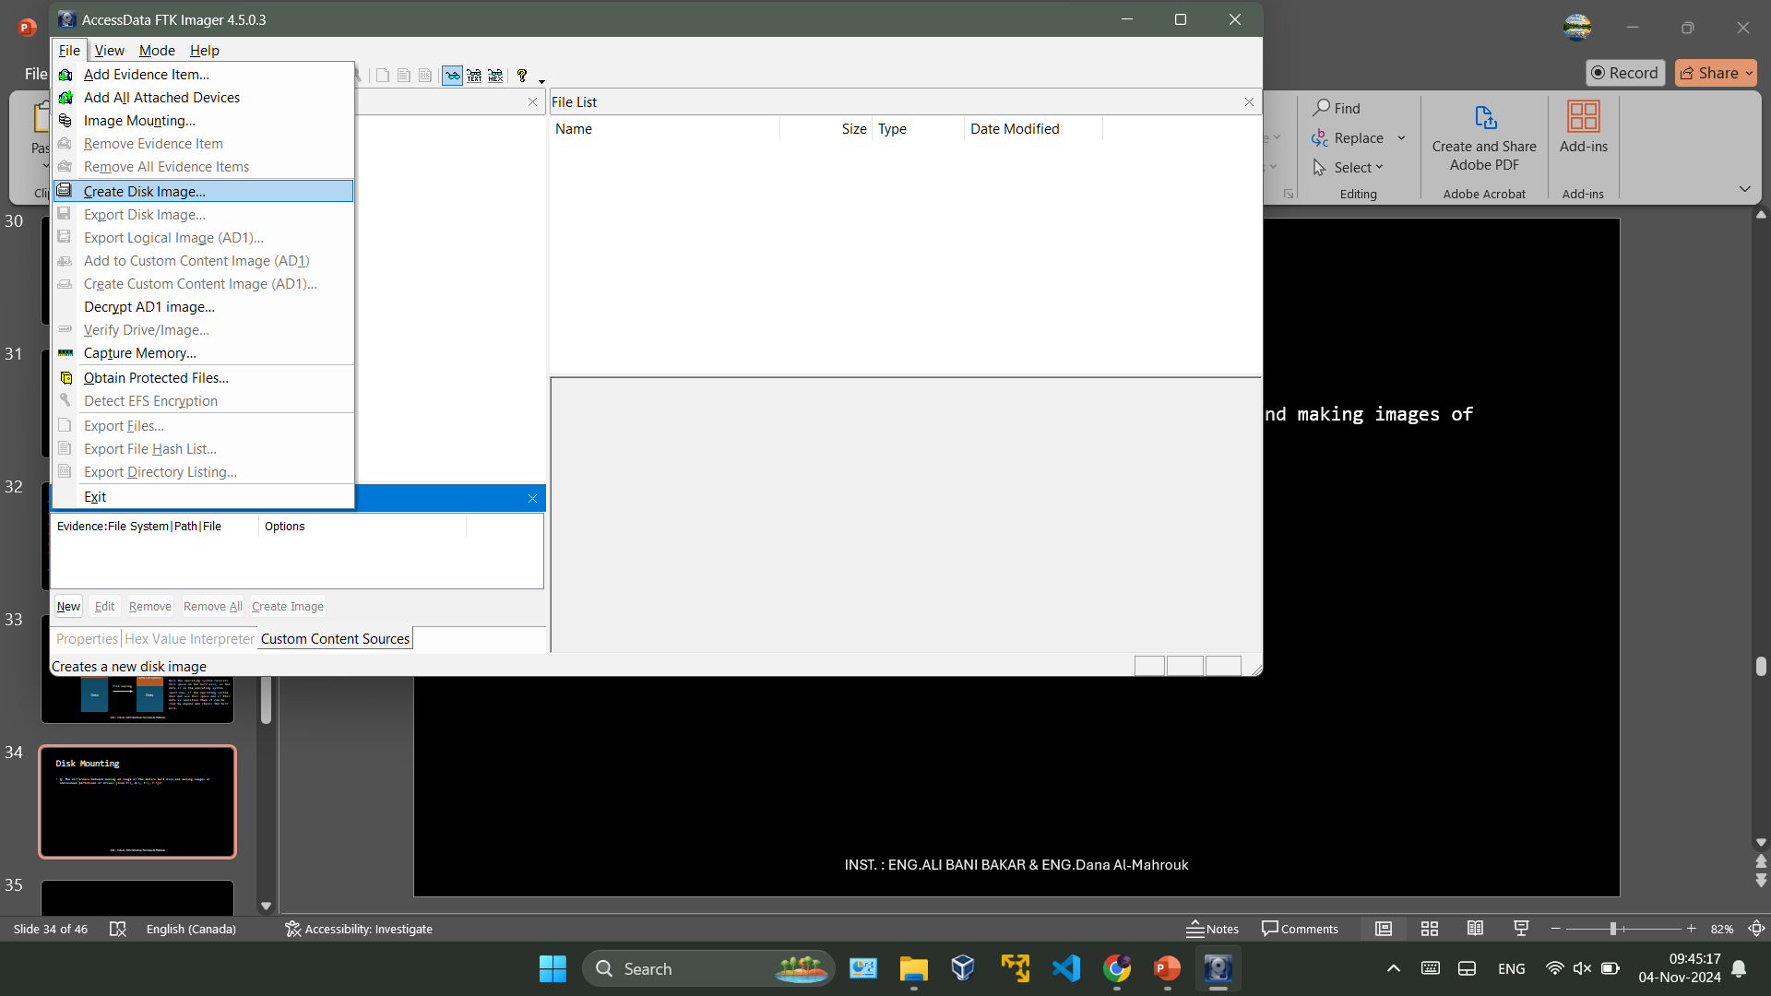
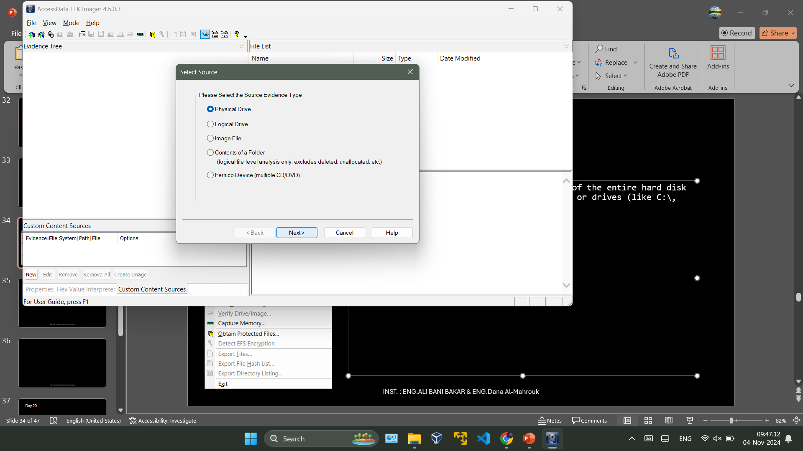
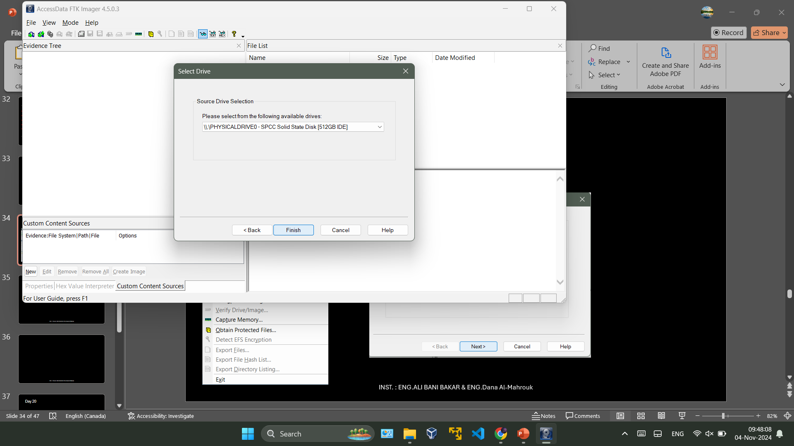
Create Disk Image

Slide 35
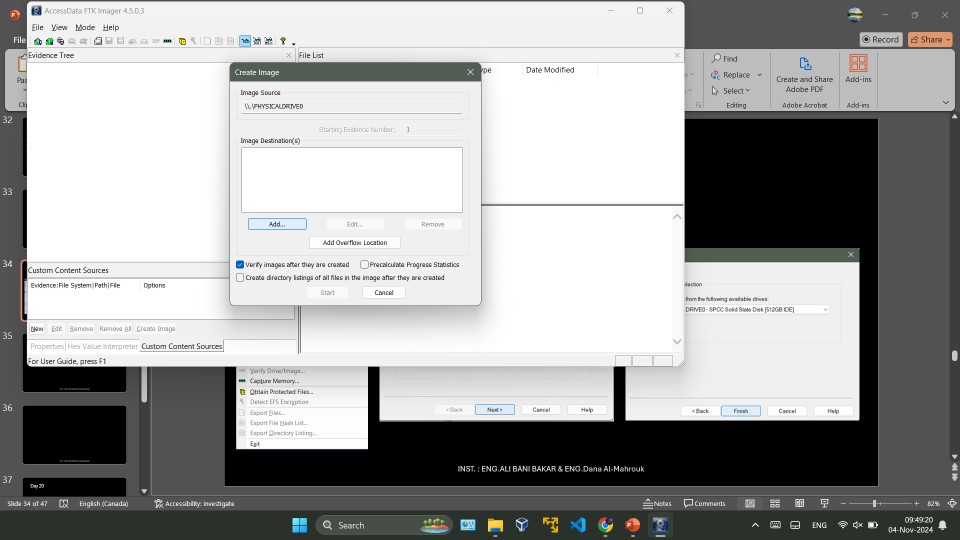
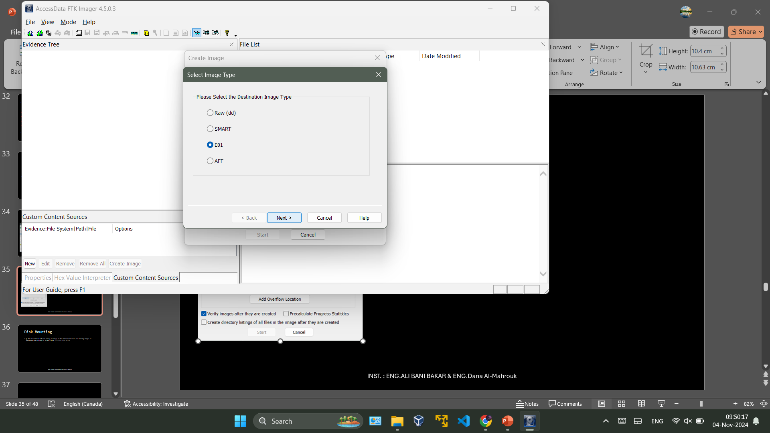
Create Disk Image

Slide 36
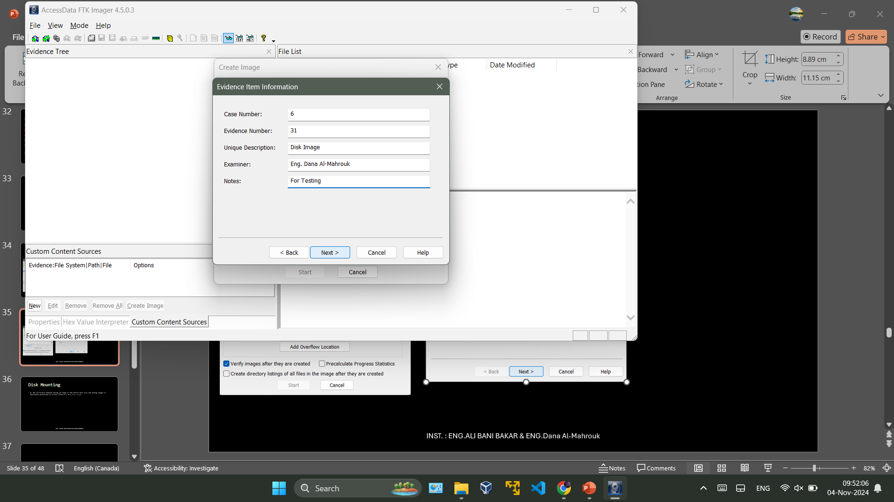
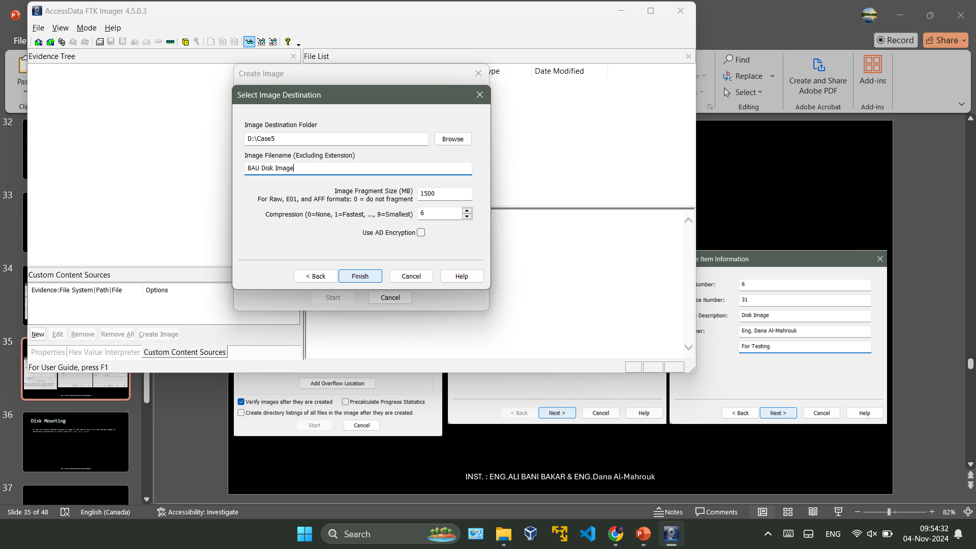
Create Disk Image

Slide 37
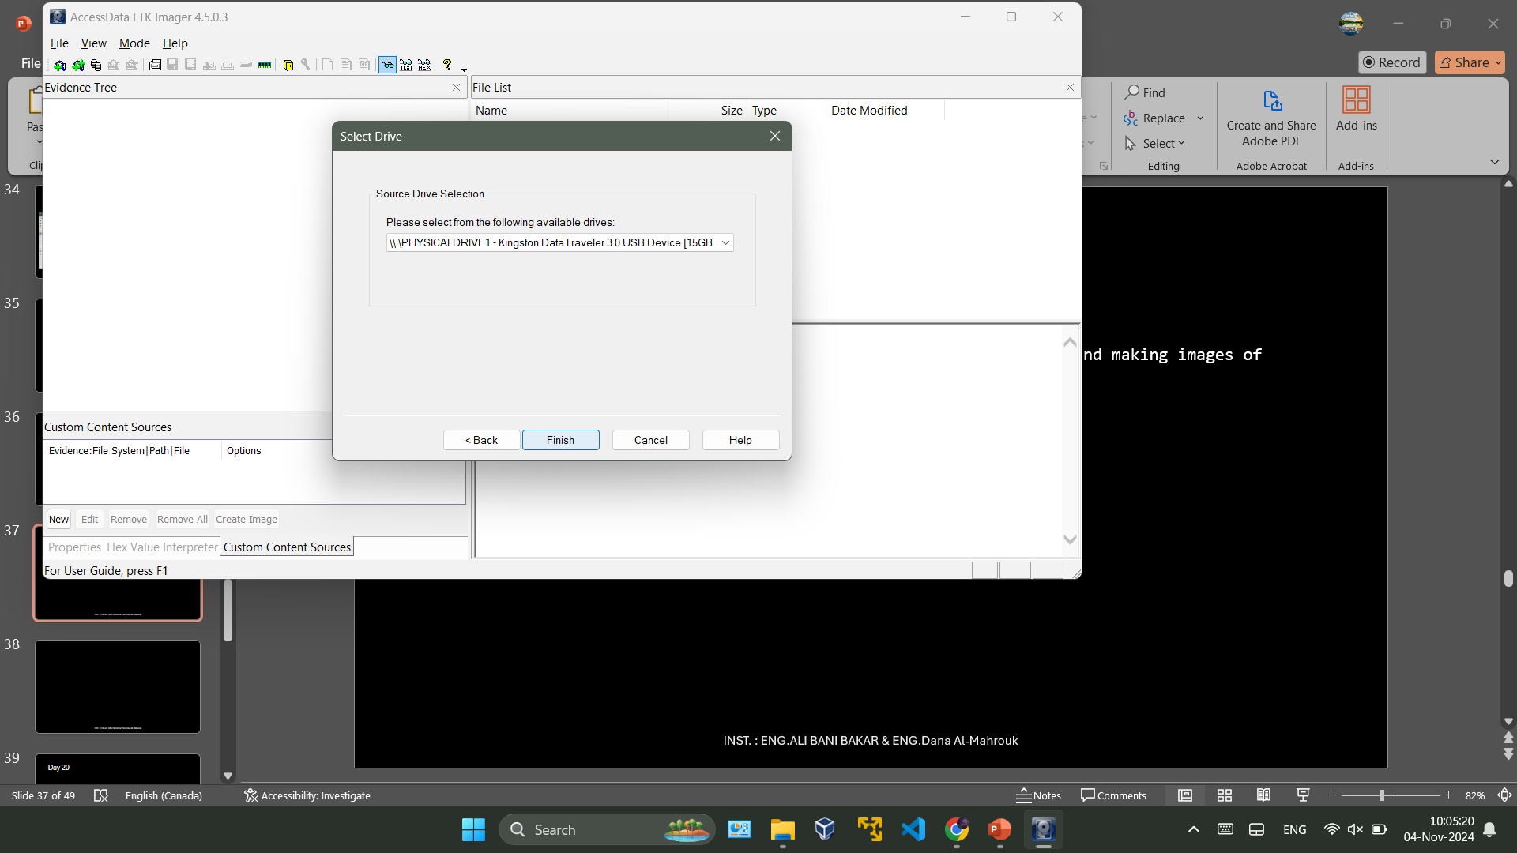
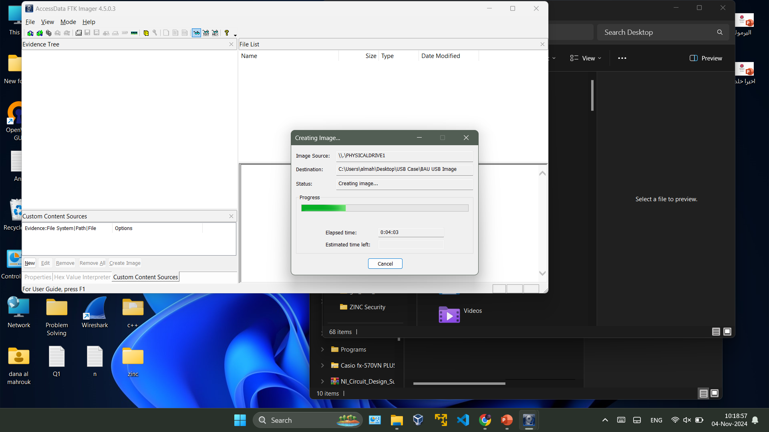
Create Disk Image (USB)

Slide 38
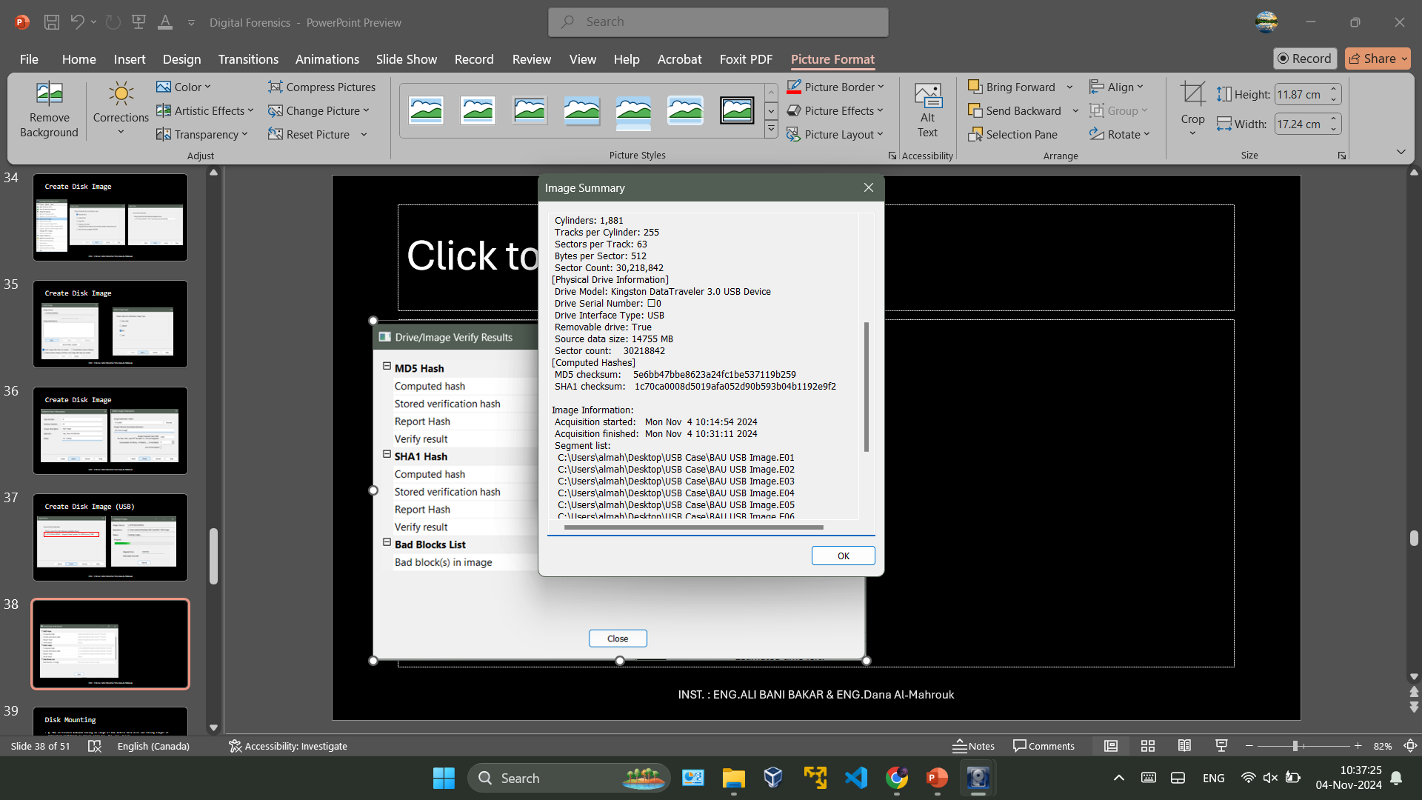
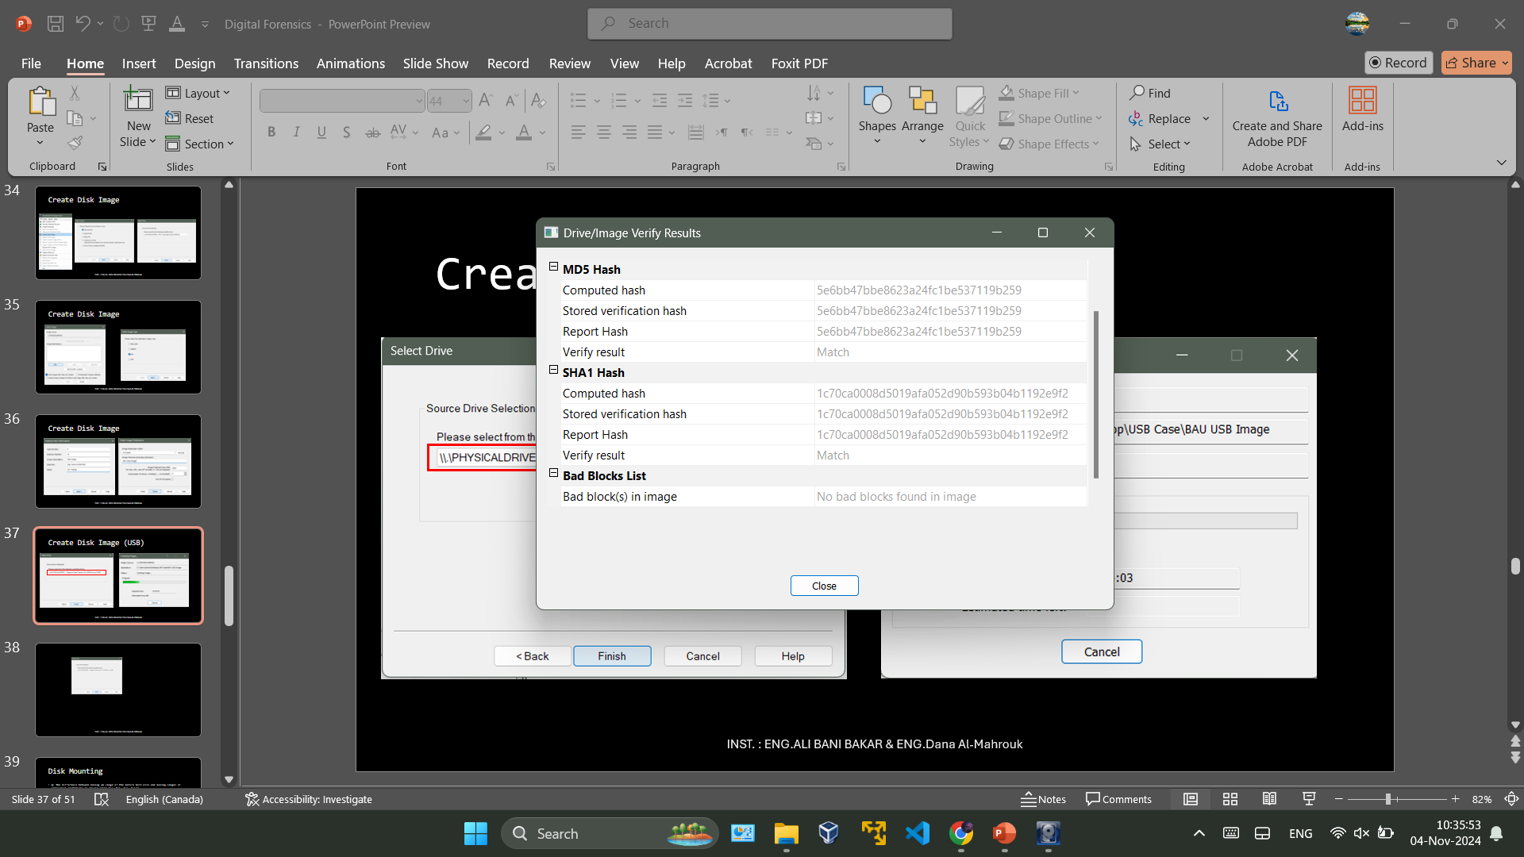
Result

Slide 39
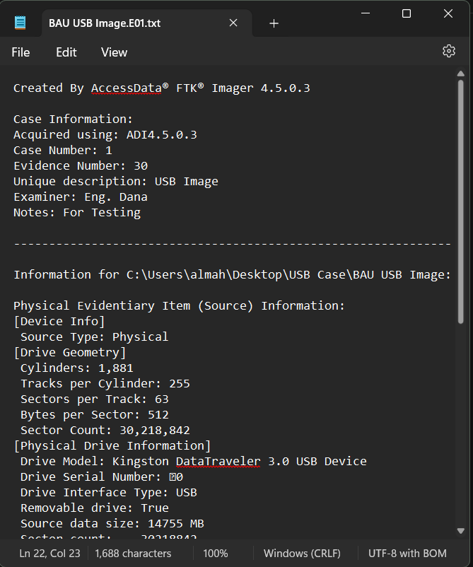
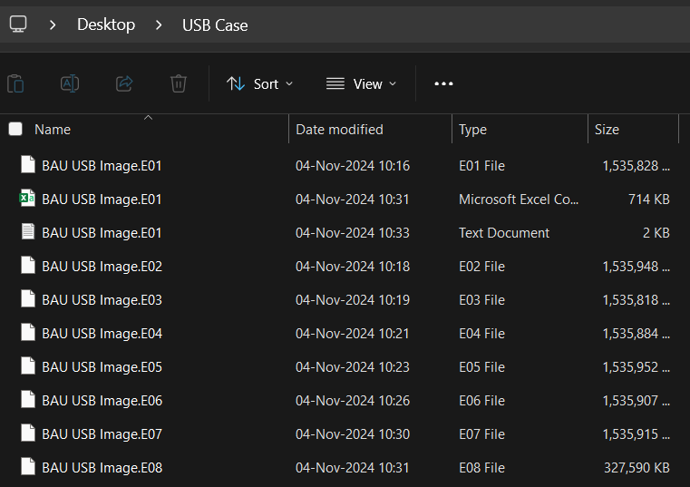
Result of USB Image

Slide 40
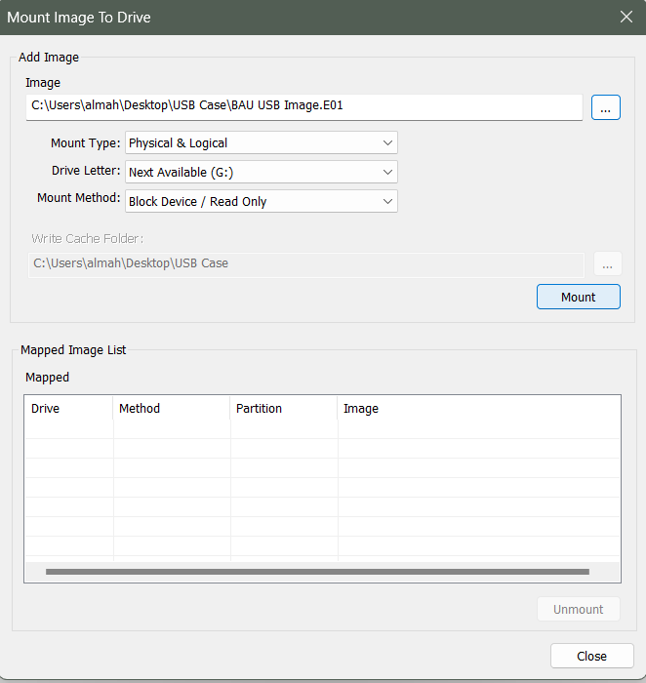
Disk Mounting
A disk image is a file that contains a complete copy of a storage device, including its file system, files, and metadata. Common formats include `.E01` (EnCase image files) and `.dd` or `.img` (raw image files).
When you mount a disk image, you are essentially telling FTK to treat the image like a physical drive or partition, allowing you to access its contents.
The software reads the disk image, interprets its file system, and makes the files and directories within that image accessible for forensic analysis.

Slide 41
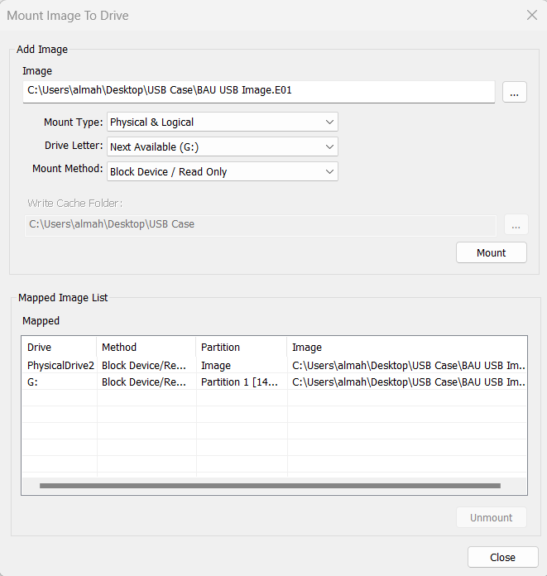
Why is Mounting
Q: Why is Mounting Important in Forensics?
Efficiency: It provides a user-friendly way to access and analyze the contents of disk images without needing to write complex scripts or commands.
Comprehensive Analysis: Mounting allows analysts to use FTK's advanced tools to conduct detailed investigations.
Data Integrity: By working with a disk image rather than the original storage device, forensic investigators can ensure that the original evidence remains unaltered and can be preserved for legal proceedings.

Slide 42
Day 20
Outline
RAM Forensics
Analyze Memory
Volatility
Imageinfo
Pslist
Pstree
Malfind
procdump -D
Dlllist
Getsids
Privs
Hashdump
Netscan
Cmdscan
Iehistory
Threads
CPU

Slide 43
RAM Forensics
`RAM Forensics`: is the process of analyzing the contents of a computer's RAM (Random Access Memory) to extract valuable information that can aid in forensic investigations.
RAM stores data temporarily while the system is running, including active processes, open files, network connections, and other volatile information that disappears when the system is powered off.
By capturing and analyzing this data, investigators can gain insights into system activity and user behavior.

Slide 44
Analyze Memory
1
2
3
Malware Program
Hidden Processes
Listening Services
4
5
6
7
Network Connection
Registry Content
DLL Analysis
Password in clear Text

Slide 45

Volatility
Volatility is a powerful memory forensics framework used to analyze RAM dumps, for forensic and incident response purposes.
Note: After Download it in Windows OS put the Application Path in Path variable in System Environment , or copy past the App in one of the Apps in Path variable (to be able to run in everywhere)
Open CMD in Windows:
volatility --info → app version & all command that you can use
OS support profile → what is the OS for Victim Device.

Slide 46
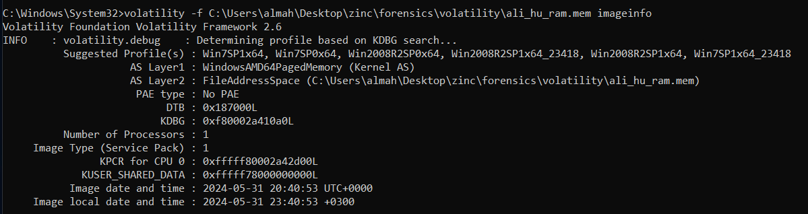
Imageinfo
volatility -f <Path\to\.mem> imageinfo
volatility -f C:\Users\almah\Desktop\zinc\forensics\volatility\ali_hu_ram.mem imageinfo

Slide 47
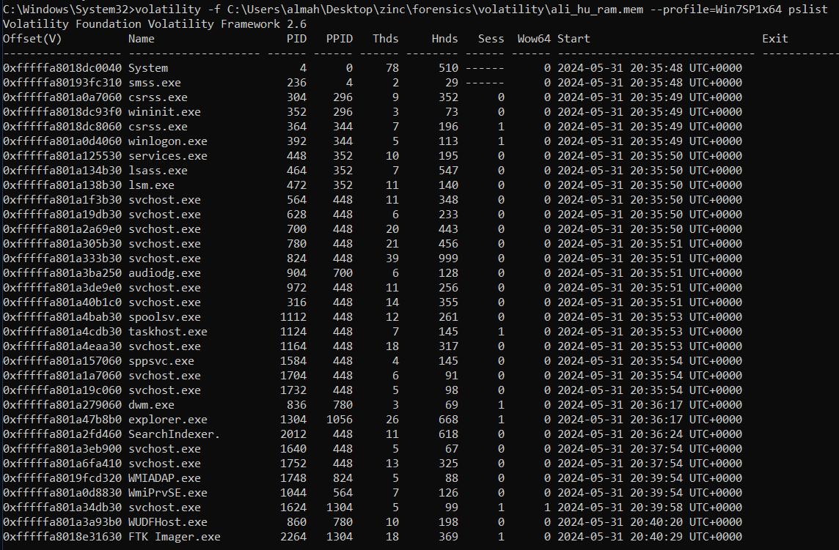

Slide 48
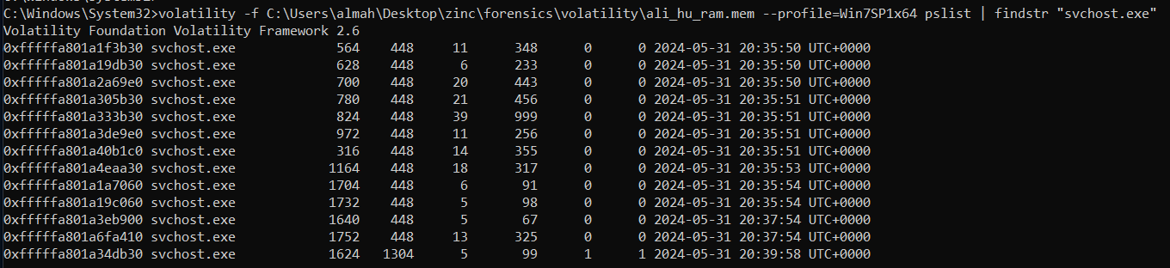
Volatility Command
volatility -f <Path\to\.mem> --profile=Win7SP1x64 pslist
--info
imageinfo
--profile = <profile-name>
pslist
findstr = <str>
volatility -f <Path\to\.mem> --profile=Win7SP1x64 pslist | findstr "svchost.exe"

Slide 49
Findstr
volatility -f <Path> --profile=Win7SP1x64 pslist | findstr "1304"

Slide 50
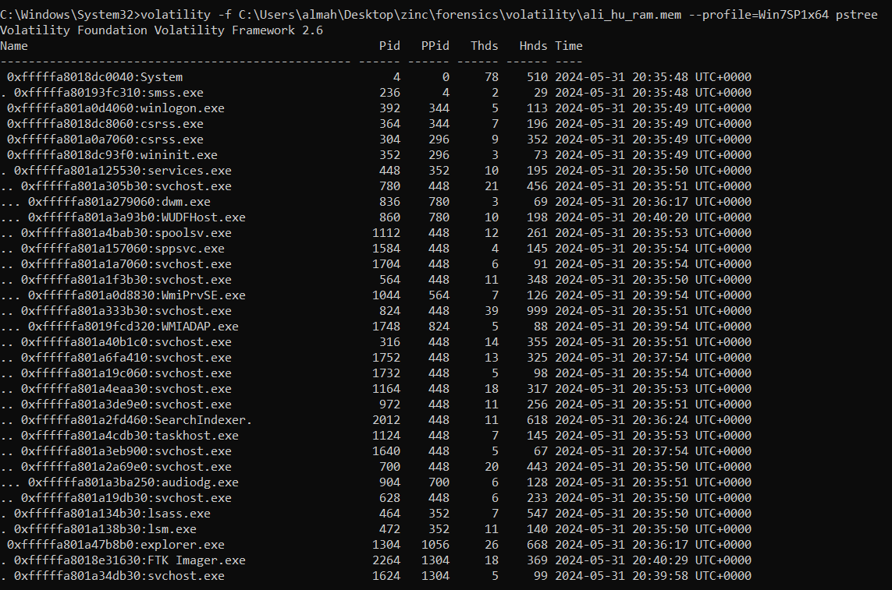

Slide 51
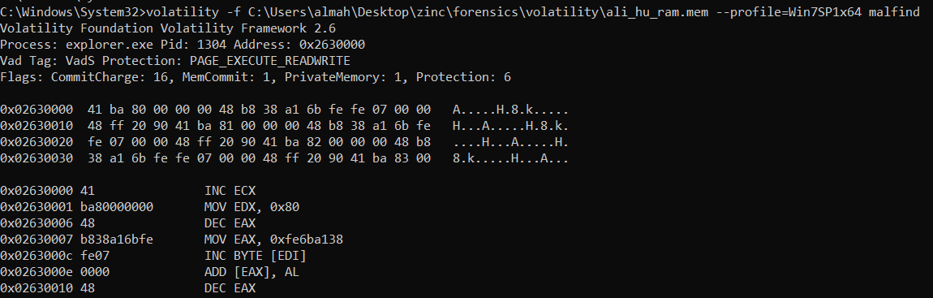
Malware Find
volatility -f <Path..> --profile=Win7SP1x64 malfind

Slide 52
procdump -D
volatility -f <Path..> --profile=Win7SP1x64 -p 1624 procdump -D "D:\Malware"

Slide 53
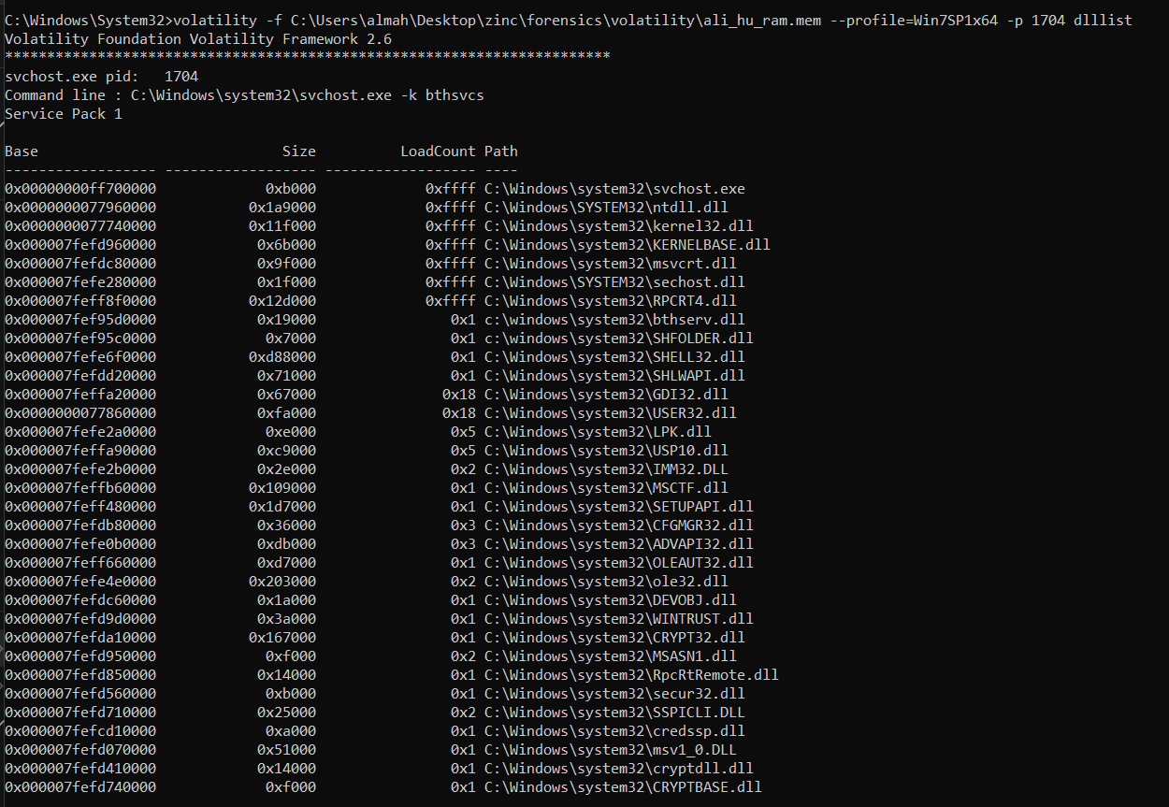

Slide 54
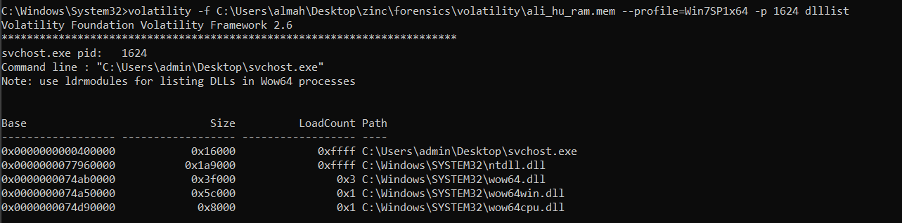
DLL List
volatility -f <Path..> --profile=Win7SP1x64 -p 1704 dlllist
volatility -f <Path..> --profile=Win7SP1x64 -p 1624 dlllist
The DLL Must Be Same, because both are same program → No (May be Malware)

Slide 55
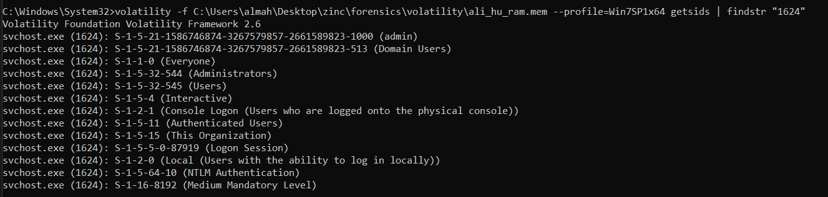
Get SID’s
volatility -f <Path..> --profile=Win7SP1x64 getsids | findstr "1624"

Slide 56
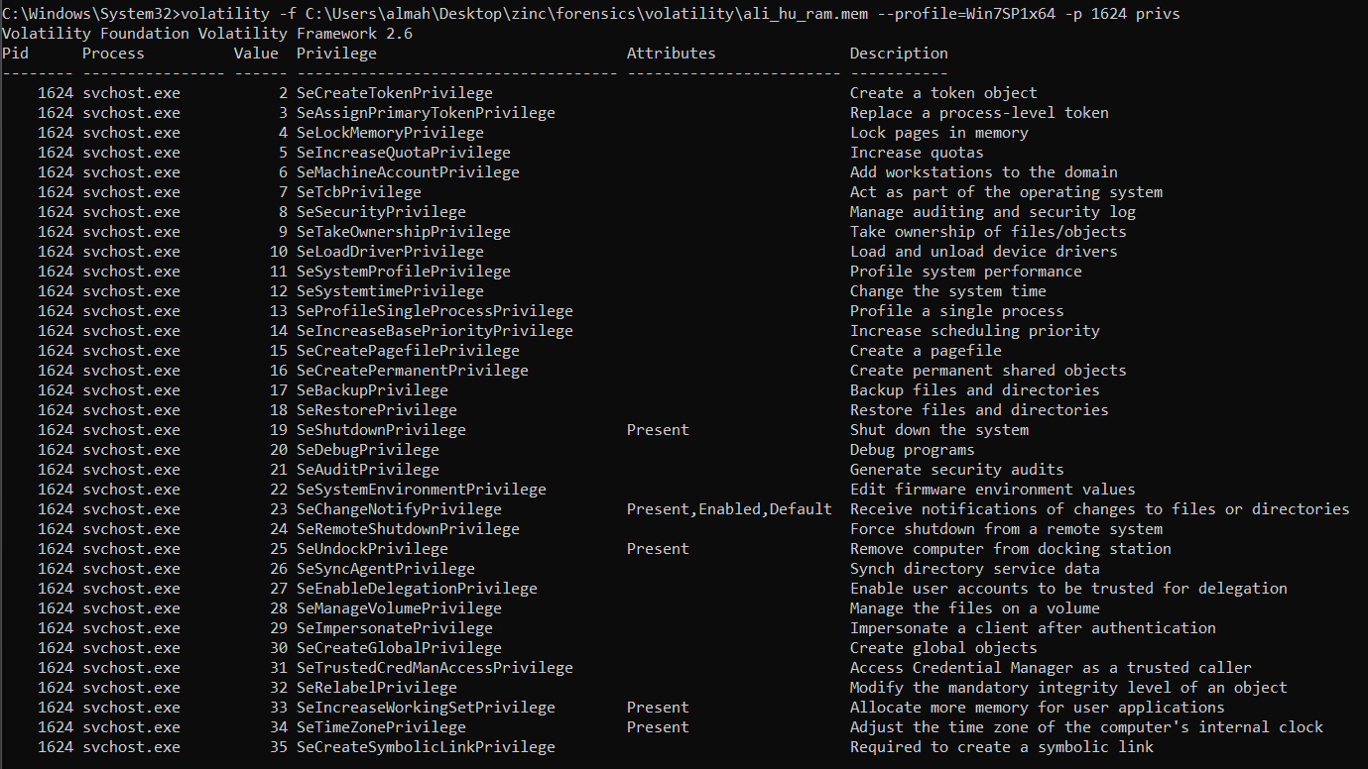

Slide 57
More….
volatility -f <Path..> --profile=Win7SP1x64 -p 1624 privs
volatility -f <Path..> --profile=Win7SP1x64 hashdump
volatility -f <Path..> --profile=Win7SP1x64 netscan
volatility -f <Path..> --profile=Win7SP1x64 cmdscan
volatility -f <Path..> --profile=Win7SP1x64 iehistory

Slide 58
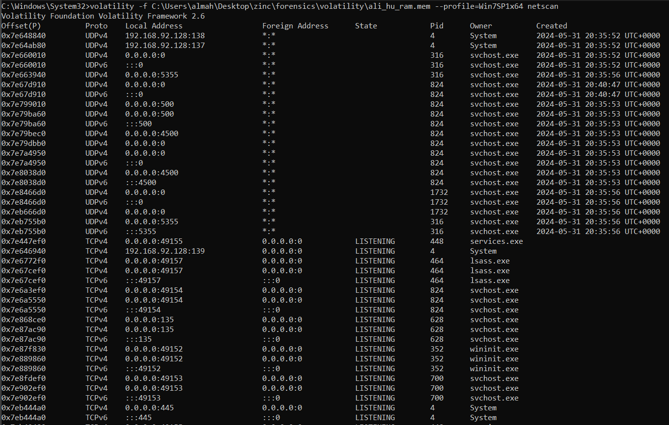

Slide 59












Volatility Command Summary
imageinfo → Identifies the profile (OS version and architecture) for the memory dump.
pslist → Lists running processes within the memory dump.
pstree → Shows processes in a tree structure, helping identify parent-child relationships.
Malfind → Scans for potentially malicious code, helping detect injected code.
procdump -D "D:\Malware” → Dumps a specified process's memory to the given directory.
Dlllist → Lists (DLLs) loaded by each process, useful for identifying injected libraries.

Slide 60












Volatility Command Summary
Getsids → Retrieves (SIDs) associated with processes, privileges and user associations.
Privs → Displays privileges associated with a specific process.
Hashdump → Extracts password hashes from the memory dump.
Netscan → Scans for network connections and open ports.
Cmdscan → Recovers command-line history from open console sessions.
Iehistory → Extracts Internet Explorer browsing history from the memory dump.

Slide 61
Volatility Command Summary
imageinfo → Identifies the profile (OS version and architecture) for the memory dump.
Pslist → Lists running processes within the memory dump.
Pstree → Shows processes in a tree structure, helping identify parent-child relationships.
Malfind → Scans for potentially malicious code within processes, helping detect injected code.
procdump -D "D:\Malware” → Dumps a specified process's memory to the given directory.
Dlllist → Lists (DLLs) loaded by each process, useful for identifying suspicious or injected libraries.
Getsids → Retrieves (SIDs) associated with processes, helpful for identifying privileges and user associations.
Privs → Displays privileges associated with a specific process, showing potential elevated permissions.
Hashdump → Extracts password hashes from the memory dump, useful for post-exploitation or forensic analysis.
Netscan → Scans for network connections and open ports, revealing network activity and potential communication with external IPs.
Cmdscan → Recovers command-line history from open console sessions.
Iehistory → Extracts Internet Explorer browsing history from the memory dump.

Slide 62
Threads
a thread is the smallest unit of a process that can be scheduled and executed independently by the operating system.
It is importance for optimizing applications that require multitasking and responsiveness.
Program
Time 1
Time 2
Time 3
Time 4
B=2
Input x
Y=B+2
C=B+3
W=B+Y
Print(B)
Print(W)
B=2
Input x
Y=B+2
C=B+3
Print(B)
W=B+Y
Print(W)

Slide 63
Register File
Program Counter
Memory
R0 | 0
R1
R2
R3
R4
R5 | 12
R6 | 123456789
R7
R8
4
0 | addi R5, R0, 12
4 | lw R6, R5
8
12 | 123456789
16
20
24
28
32
Instruction Register
Lw R6, R5
Control Unit
Memory Address
ALU
12
Pass Trough
Data Register
123456789

Slide 64
Day 21
Outline
DOS Attack
DOS Attack Lab
DDOS Attack
Image Resolution
RGB (Red Green Blue)
RBG Matrix Example (smiley face)

Slide 65




DOS Attack
Hacker
Server
is a malicious attempt to disrupt the normal functioning of a targeted server, service, or network by overwhelming it with a flood of unnecessary requests.
This overloads the system, making it unresponsive to legitimate users.
During a DoS attack, legitimate users experience increased waiting time or latency as the system struggles to respond.
Firewall & IDS: Detect and block suspicious traffic.
Syn
Syn Ack
3-way Handshake
Ack
Open Session
Waiting Time

Slide 66

DOS Attack Lab
Kali
Metasploitable
Windows 7
sudo hping3 -1 --flood 192.168.92.131&
(1 Million packet/sec)
Open internet explorer and Open the Web server of Metaploitable.
Ping 192.168.92.131
Ping -t 192.168.92.131
Syn
Syn Ack
3-way Handshake
Ack
Open Session

Slide 67


DDOS Attack
Botnet
Bot
Hacker
Command & Control
Server
Bot
Firewall
Server
Bot

Slide 68
DDOS Attack
is an advanced form of (DoS) attack where multiple compromised systems, often part of a botnet, are used to flood a target with traffic, causing disruption or complete downtime.
The distributed nature makes it much harder to detect and defend against.
traffic comes from thousands or even millions of devices spread across different geographic locations. This makes it difficult to distinguish between legitimate traffic and malicious requests.

Slide 69
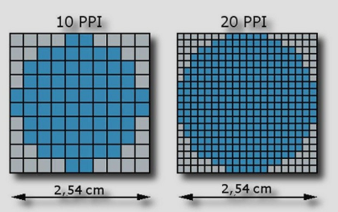


Image Resolution
It describes the sharpness or clarity of the image, with higher resolutions offering more detail.
Format | Compression | Transparency | Best For | File Size
JPEG (.jpg) | Lossy | No | Photographs, web images | Small
PNG (.png) | Lossless | Yes | Logos, icons, graphics | Medium
BMP (.bmp) | Uncompressed | Limited | Image editing, archival | Large

Slide 70
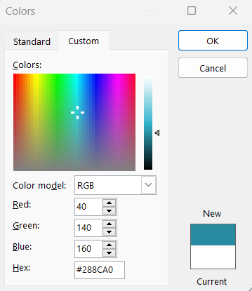
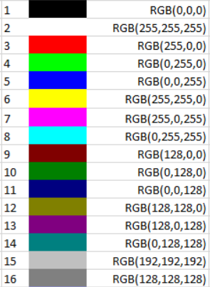
RGB (Red Green Blue)
Each color component (Red, Green, and Blue) can have a value from `0 to 255`, representing its intensity.
`0` means no contribution of that color.
`255` is the maximum intensity of that color.
By varying the intensity of each of these three colors, you can create millions of different colors.

Slide 71


RBG Matrix Example
Group of Pixel
Image

Slide 72
255 | 255 | 255 | 255 | 255 | 255 | 0 | 0 | 0 | 0 | 255 | 255 | 255 | 255 | 255 | 255
255 | 255 | 255 | 255 | 0 | 0 | 255 | 255 | 255 | 255 | 0 | 0 | 255 | 255 | 255 | 255
255 | 255 | 255 | 0 | 255 | 255 | 255 | 255 | 255 | 255 | 255 | 255 | 0 | 255 | 255 | 255
255 | 255 | 0 | 255 | 255 | 255 | 255 | 255 | 255 | 255 | 255 | 255 | 255 | 0 | 255 | 255
255 | 0 | 255 | 255 | 255 | 255 | 255 | 255 | 255 | 255 | 255 | 255 | 255 | 255 | 0 | 255
255 | 0 | 255 | 255 | 0 | 0 | 255 | 255 | 255 | 255 | 0 | 0 | 255 | 255 | 0 | 255
0 | 255 | 255 | 255 | 0 | 0 | 255 | 255 | 255 | 255 | 0 | 0 | 255 | 255 | 255 | 0
0 | 255 | 255 | 255 | 255 | 255 | 255 | 255 | 255 | 255 | 255 | 255 | 255 | 255 | 255 | 0
0 | 255 | 255 | 255 | 255 | 255 | 255 | 255 | 255 | 255 | 255 | 255 | 255 | 255 | 255 | 0
0 | 255 | 255 | 255 | 0 | 255 | 255 | 255 | 255 | 255 | 255 | 0 | 255 | 255 | 255 | 0
255 | 0 | 255 | 255 | 255 | 0 | 255 | 255 | 255 | 255 | 0 | 255 | 255 | 255 | 0 | 255
255 | 0 | 255 | 255 | 255 | 255 | 0 | 0 | 0 | 0 | 255 | 255 | 255 | 255 | 0 | 255
255 | 255 | 0 | 255 | 255 | 255 | 255 | 255 | 255 | 255 | 255 | 255 | 255 | 0 | 255 | 255
255 | 255 | 255 | 0 | 255 | 255 | 255 | 255 | 255 | 255 | 255 | 255 | 0 | 255 | 255 | 255
255 | 255 | 255 | 255 | 0 | 0 | 255 | 255 | 255 | 255 | 0 | 0 | 255 | 255 | 255 | 255
255 | 255 | 255 | 255 | 255 | 255 | 0 | 0 | 0 | 0 | 255 | 255 | 255 | 255 | 255 | 255

Slide 73
255 | 255 | 255 | 255 | 255 | 255 | 0 | 0 | 0 | 0 | 255 | 255 | 255 | 255 | 255 | 255
255 | 255 | 255 | 255 | 0 | 0 | 255 | 255 | 120 | 120 | 0 | 0 | 255 | 255 | 255 | 255
255 | 255 | 255 | 0 | 255 | 255 | 255 | 255 | 255 | 255 | 120 | 120 | 0 | 255 | 255 | 255
255 | 255 | 0 | 255 | 255 | 255 | 255 | 255 | 255 | 255 | 255 | 255 | 120 | 0 | 255 | 255
255 | 0 | 255 | 255 | 255 | 255 | 255 | 255 | 255 | 255 | 255 | 255 | 255 | 120 | 0 | 255
255 | 0 | 255 | 255 | 0 | 0 | 255 | 255 | 255 | 255 | 0 | 0 | 255 | 120 | 0 | 255
0 | 255 | 255 | 255 | 0 | 0 | 255 | 255 | 255 | 255 | 0 | 0 | 255 | 255 | 255 | 0
0 | 255 | 255 | 255 | 255 | 255 | 255 | 255 | 255 | 255 | 255 | 255 | 255 | 255 | 255 | 0
0 | 255 | 255 | 255 | 255 | 255 | 255 | 255 | 255 | 255 | 255 | 255 | 255 | 255 | 255 | 0
0 | 255 | 255 | 255 | 0 | 255 | 255 | 255 | 255 | 255 | 255 | 0 | 255 | 255 | 255 | 0
255 | 0 | 255 | 255 | 255 | 0 | 255 | 255 | 255 | 255 | 0 | 255 | 255 | 255 | 0 | 255
255 | 0 | 255 | 255 | 255 | 255 | 0 | 0 | 0 | 0 | 255 | 255 | 255 | 255 | 0 | 255
255 | 255 | 0 | 255 | 255 | 255 | 255 | 255 | 255 | 255 | 255 | 255 | 255 | 0 | 255 | 255
255 | 255 | 255 | 0 | 255 | 255 | 255 | 255 | 255 | 255 | 255 | 255 | 0 | 255 | 255 | 255
255 | 255 | 255 | 255 | 0 | 0 | 255 | 255 | 255 | 255 | 0 | 0 | 255 | 255 | 255 | 255
255 | 255 | 255 | 255 | 255 | 255 | 0 | 0 | 0 | 0 | 255 | 255 | 255 | 255 | 255 | 255

Slide 74
255 | 255 | 255 | 255 | 255 | 255 | 0 | 0 | 0 | 0 | 255 | 255 | 255 | 255 | 255 | 255
255 | 255 | 255 | 255 | 0 | 0 | 45 | 45 | 0 | 0 | 0 | 0 | 255 | 255 | 255 | 255
255 | 255 | 255 | 0 | 45 | 45 | 45 | 45 | 45 | 45 | 0 | 0 | 0 | 255 | 255 | 255
255 | 255 | 0 | 45 | 45 | 45 | 45 | 45 | 45 | 45 | 45 | 45 | 0 | 0 | 255 | 255
255 | 0 | 45 | 45 | 45 | 45 | 45 | 45 | 45 | 45 | 45 | 45 | 45 | 0 | 0 | 255
255 | 0 | 45 | 45 | 0 | 0 | 45 | 45 | 45 | 45 | 0 | 0 | 45 | 0 | 0 | 255
0 | 45 | 45 | 45 | 0 | 0 | 45 | 45 | 45 | 45 | 0 | 0 | 45 | 45 | 45 | 0
0 | 45 | 45 | 45 | 45 | 45 | 45 | 45 | 45 | 45 | 45 | 45 | 45 | 45 | 45 | 0
0 | 45 | 45 | 45 | 45 | 45 | 45 | 45 | 45 | 45 | 45 | 45 | 45 | 45 | 45 | 0
0 | 45 | 45 | 45 | 0 | 45 | 45 | 45 | 45 | 45 | 45 | 0 | 45 | 45 | 45 | 0
255 | 0 | 45 | 45 | 45 | 0 | 45 | 45 | 45 | 45 | 0 | 45 | 45 | 45 | 0 | 255
255 | 0 | 45 | 45 | 45 | 45 | 0 | 0 | 0 | 0 | 45 | 45 | 45 | 45 | 0 | 255
255 | 255 | 0 | 45 | 45 | 45 | 45 | 45 | 45 | 45 | 45 | 45 | 45 | 0 | 255 | 255
255 | 255 | 255 | 0 | 45 | 45 | 45 | 45 | 45 | 45 | 45 | 45 | 0 | 255 | 255 | 255
255 | 255 | 255 | 255 | 0 | 0 | 45 | 45 | 45 | 45 | 0 | 0 | 255 | 255 | 255 | 255
255 | 255 | 255 | 255 | 255 | 255 | 0 | 0 | 0 | 0 | 255 | 255 | 255 | 255 | 255 | 255

Slide 75
Day 22
Outline
Autopsy
Data Sources
Views
By Extension
By MIME
Deleted Files
File System
Extracted Content
EXIF Metadata
Encryption Suspected
Extension Mismatch Detected
Recent Documents
Web Bookmarks
Web Cookies
Web Downloads
Web History
Web Search

Slide 76
Day 22
Outline
Autopsy
Keyword Hits
Single Literal Keyword Search
Single Regular Expression Search
Email Addresses
Hashset Hits
Email Messages
Interesting Items
Accounts
Create Case in Autopsy
SCO
S (Hash set)
C (Comment)
O (Occurrences)
Repository

Slide 77
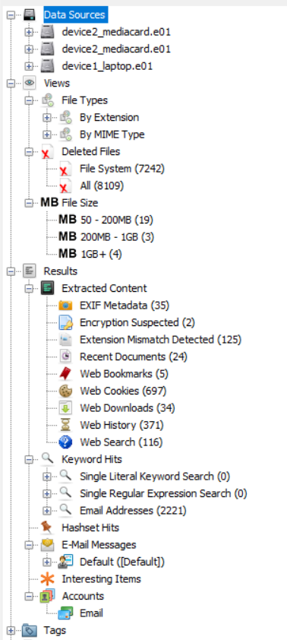

Autopsy
Autopsy is a powerful digital forensics tool used to analyze hard drives, memory dumps, and other forms of digital evidence.
It’s an open-source, graphical interface for The Sleuth Kit (TSK), a collection of command-line tools for forensic analysis.
1. Data Sources
`device2_mediacard.e01` and `device1_laptop.e01`:
These are disk images from different devices
Each `.e01` file represents an EnCase forensic image, a common format in digital forensics. By analyzing these images, investigators can access a snapshot of the device's data at the time it was captured.

Slide 78
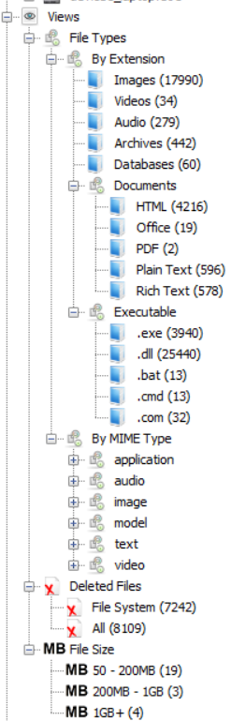
Views
File Types: Categorizes files by their types, this helps quickly identify specific file formats, and find if there are any miss match.
By Extension: Organizes files based on their file extensions, like (.jpg .pdf .docx, …) as users might see them in a file explorer..
By MIME (Multipurpose Internet Mail Extensions) type: a standard way to specify the nature of a file based on its contents.
Deleted Files: Lists files that have been deleted, which may still be recoverable.
File System: Shows a full view of all files, even system and hidden files. This is essential for understanding the underlying structure of the data and identifying any suspicious files that may not be easily visible.

Slide 79
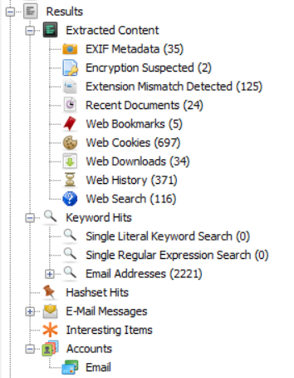
Results
A] Extracted Content:
EXIF Metadata: EXIF data, found in images, can reveal details like the camera model, date/time taken, and sometimes GPS location.
Encryption Suspected: Flags files that may be encrypted.
Extension Mismatch Detected: Identifies files whose extension doesn’t match its actual type.
Recent Documents: Lists files recently opened or edited. Useful for understanding which documents were actively used by the user.
Web Bookmarks: Displays saved web bookmarks.
Web Cookies: Lists web cookies, which track user sessions and preferences on websites.
Web Downloads: Tracks downloaded files, helping identify content that the user intentionally saved to the device.
Web History: Shows the browsing history, which provides insights into the websites the user visited.
Web Search: Lists search queries, indicating topics the user was interested in.

Slide 80
Results
B] Keyword Hits:
`Single Literal Keyword Search` and `Single Regular Expression Search`: Searches for specific keywords or patterns (like email addresses, credit card numbers, or flagged terms) across the data.
Email Addresses: Detects email addresses across files. This could be useful for identifying user accounts, contacts, or communication recipients.
C] Hashset Hits: Uses a hash database to compare file hashes, identifying known files, either trusted or malicious, depending on the database.
D] Email Messages: Lists and organizes email data, showing sender, recipient, subject, and content.
E] Interesting Items: Automatically flagged files based on criteria like unusual activity, high frequency of modification, or potential relevance to the investigation. Examples might include financial records or communication logs.
F] Accounts: Shows user accounts associated with the device, helping identify who accessed or controlled the device.

Slide 81
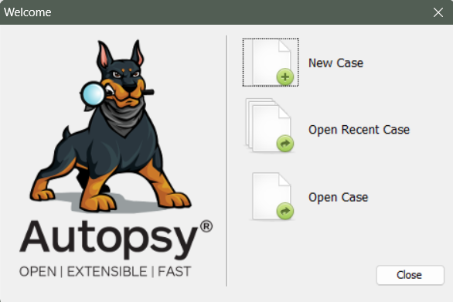
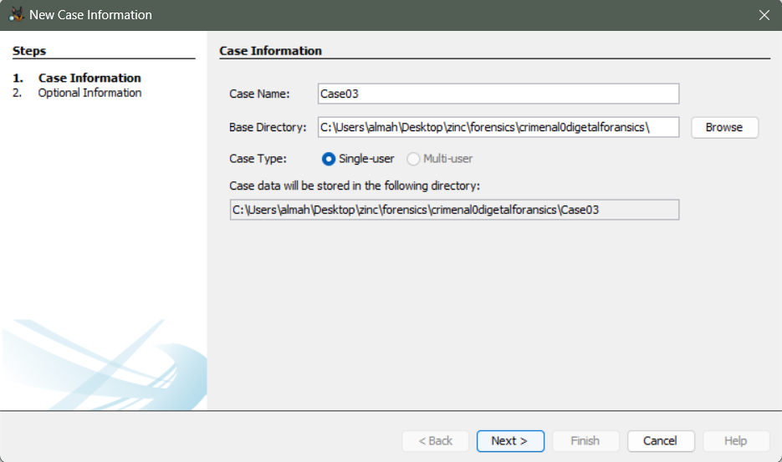
Create Case

Slide 82
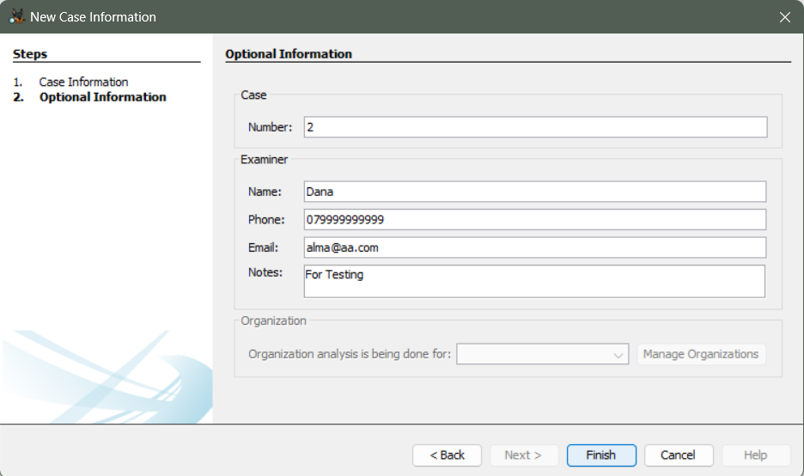
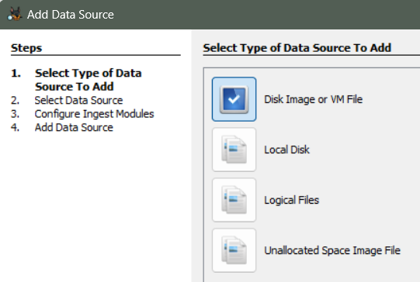
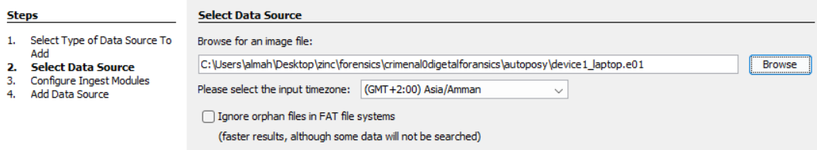

Slide 83
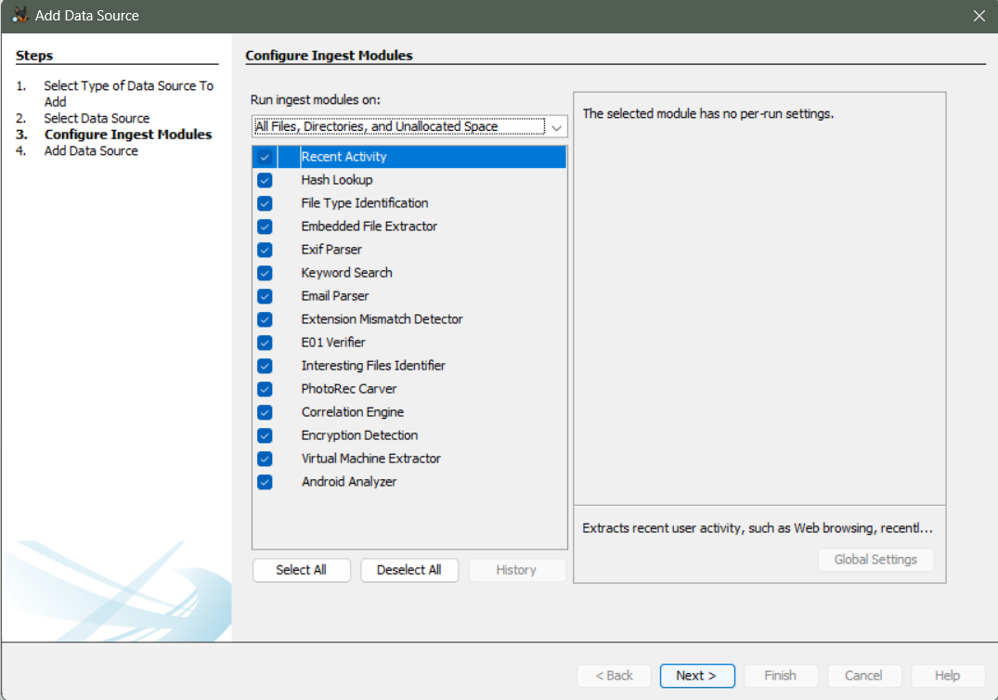

Slide 84



SCO Colum
S (Hash set) → This indicates that a file’s hash matches a known hash in a hash set. victim hash == hacker hash
C (Comment) → A comment attached to a file by the investigator or an automated tool to add context or notes about that file.
O (Occurrences) → Indicates that the file has appeared in multiple cases, which can be crucial in identifying shared or commonly used files.

Slide 85





S (Hash set)
SHA 256
Hacker File
Comparator
Hash Value 1
Hash Function
(Output)
H1 == H2
Yes, or No?
SHA 256
Clear Text
(Input)
victim hash == hacker hash??
Victim File
Hash Value 2
Hash Function
(Output)

Slide 86
Repository
Case1
Case2
Case3
File.txt
Flower.png
Case7
Case8
Case10
Flower.png
Flower.png

Slide 87
Day 23
Outline
Data Artifacts
Web Artifacts
OS Artifacts
File System Artifacts
Application Artifacts
System Configuration Artifacts
Executable and Malware Artifacts
Keyword and Hash Set Matches
USP (Uninterruptible Power Supply)

Slide 88
Data Artifacts
Keyword and Hash Set Matches
Application Artifacts
Keyword Hits
Hash Set Hits
Email Artifacts
Chat and Messaging Artifacts
Application Logs
Web Artifacts
Web History
Web Bookmarks
Web Cookies
Web Downloads
System Configuration Artifacts
OS Artifacts
Windows Registry
System Logs
Network Configuration
Recent Documents
User Accounts
Recycle Bin
Prefetch Files (Windows)
Executable and Malware Artifacts
File System Artifacts
Suspicious Executables
Hash Matches
Running Processes and Memory Dumps
File Metadata
Deleted Files
File Permissions

Slide 89
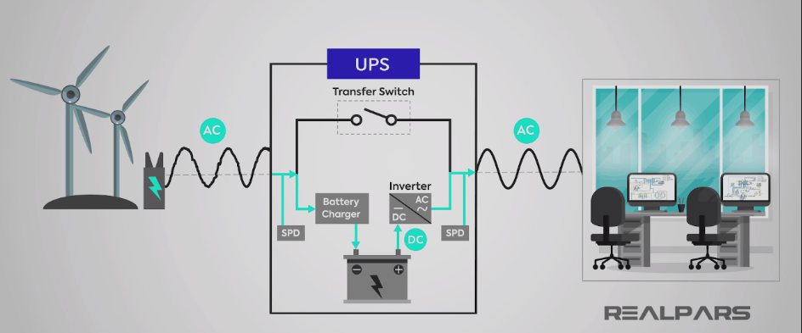
USP (Uninterruptible Power Supply)

Slide 90
(Uninterruptible Power Supply)
is a device that provides backup power to electronic devices in case of a power failure or fluctuation. It helps protect critical equipment from unexpected shutdowns, data loss, and potential damage from power issues.

